Slide 1

Chatbot Optimization
신한DS 금융 SW아카데미 3기
정민교

Slide 2
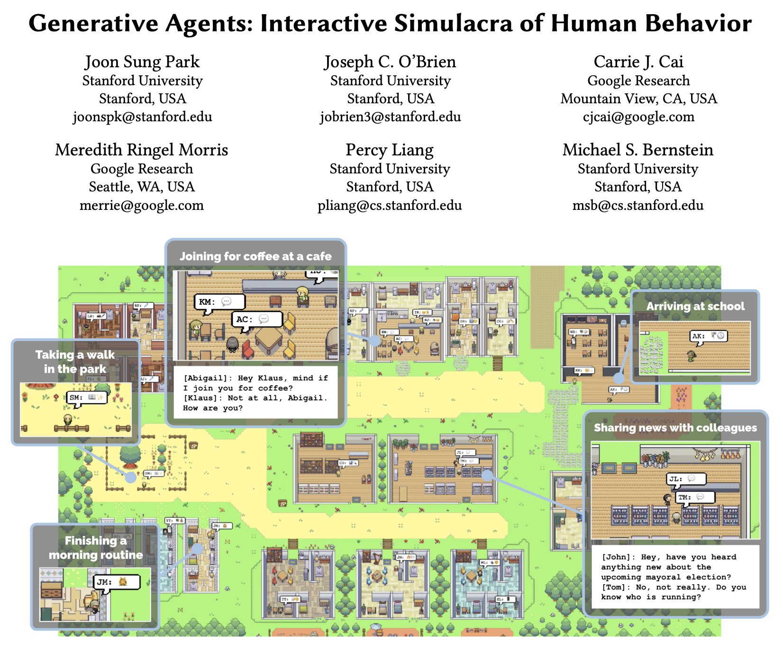
Inspiration
Park, J. S., O'Brien, J. C., Cai, C. J., Morris, M. R., Liang, P., & Bernstein, M. S. (2023). Generative Agents: Interactive Simulacra of Human Behavior. The 36th Annual ACM Symposium on User Interface Software and Technology (UIST ’23), October 29-November 1, San Francisco, CA, USA. https://doi.org/10.1145/3586183.3606763

Slide 3

챗봇을 이용한 서비스를 만들 때 어떻게 하면 효과적으로 운영할 수 있을까?

Slide 4




Development Purpose
Chatbot Memory
Reducing tokens usage
Studying JDBC

Slide 5
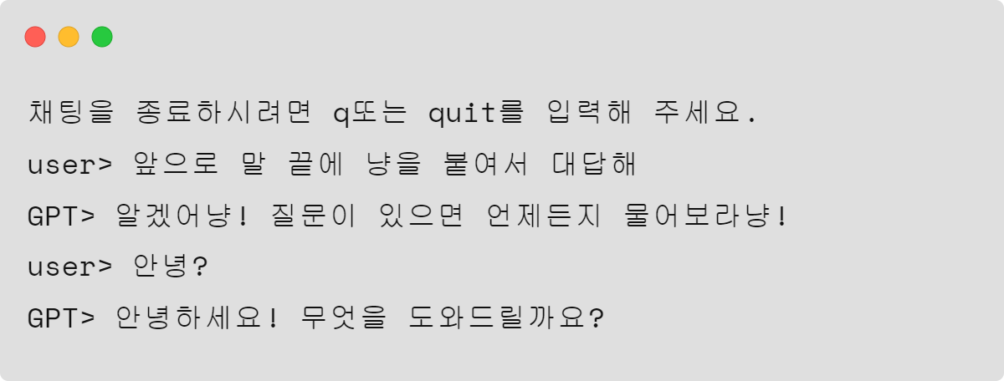
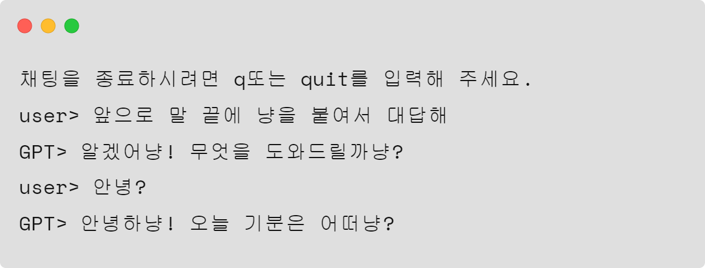
Chatbot Memory
Memory Off
Memory On

Slide 6
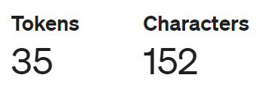
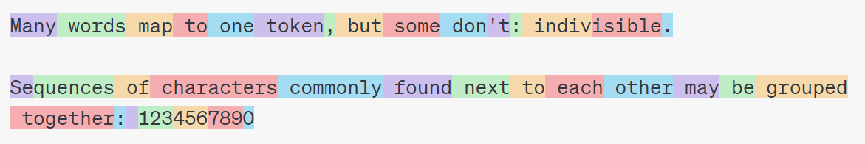
Reducing tokens usage : Token
Token↑ = execution time↓, price ↑

Slide 7
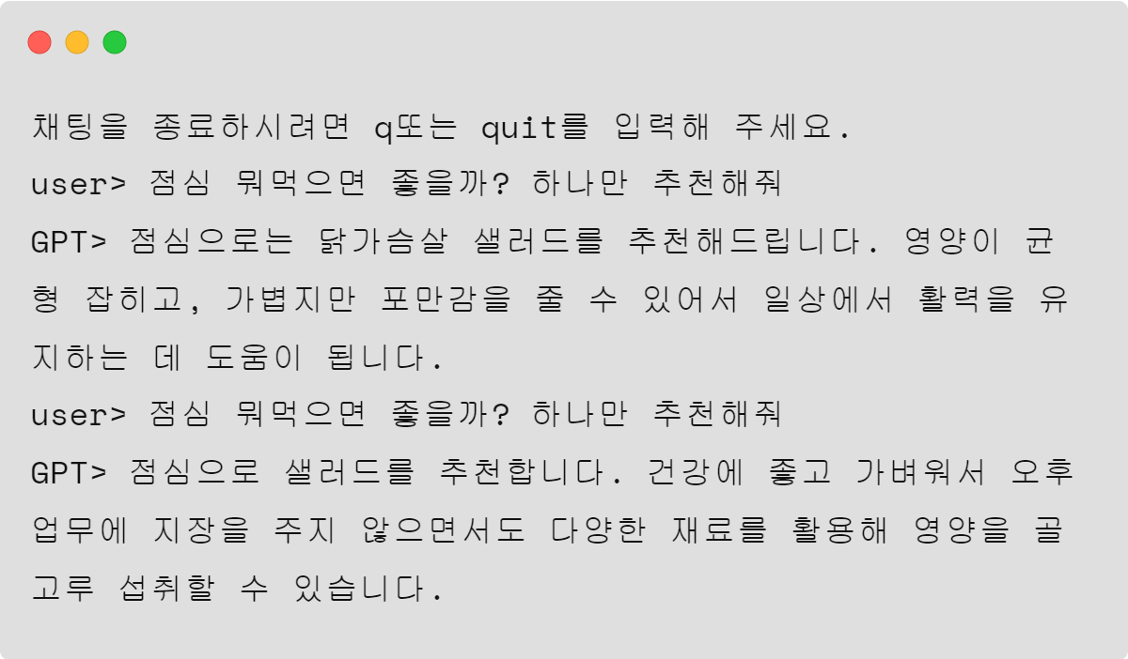
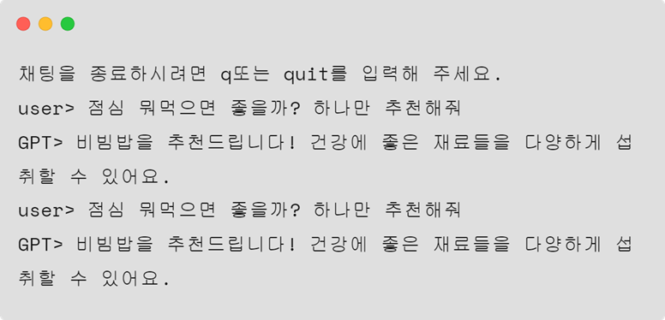
Reducing tokens usage : Cache
Cache Off
Execution time : 2.76s
Cache On
Execution time : 0.04s

Slide 8
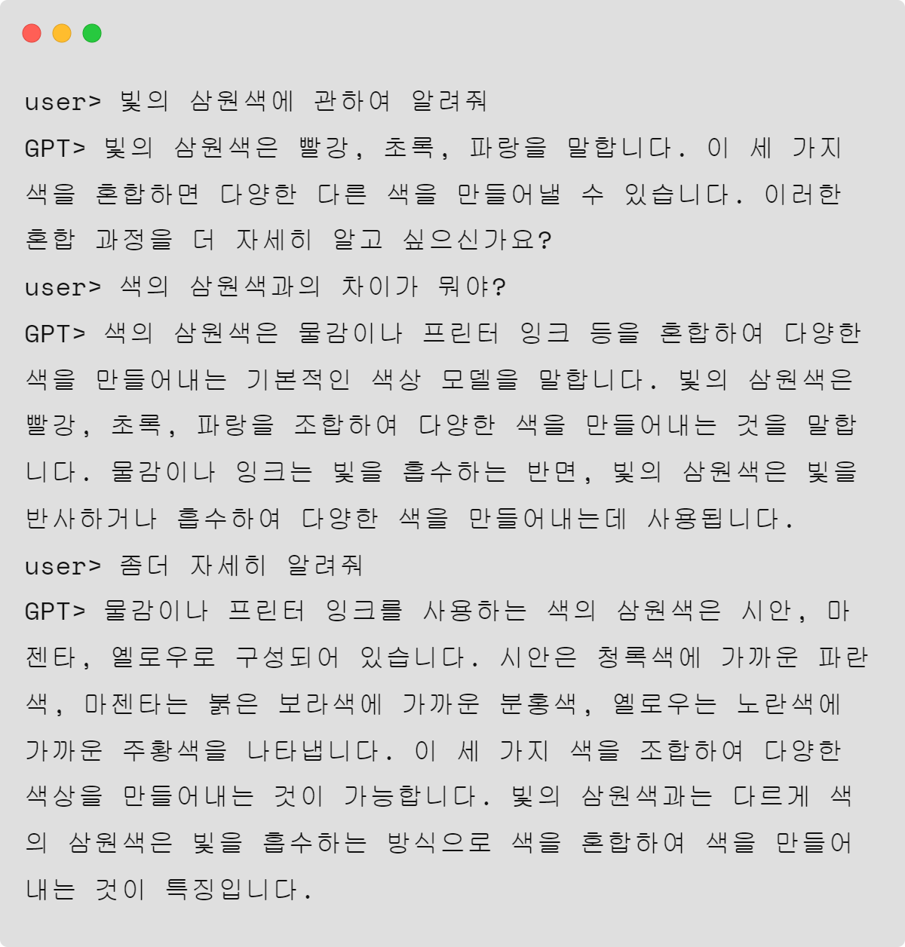
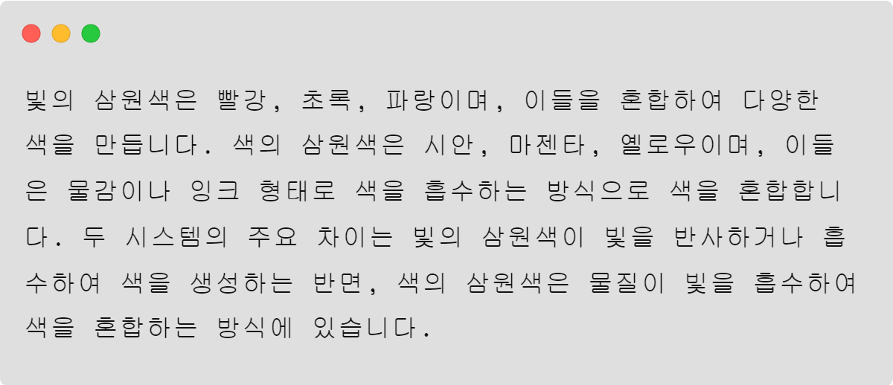
Reducing tokens usage : Summary
Original
Total tokens : 573
Summary
Total tokens : 201

Slide 9
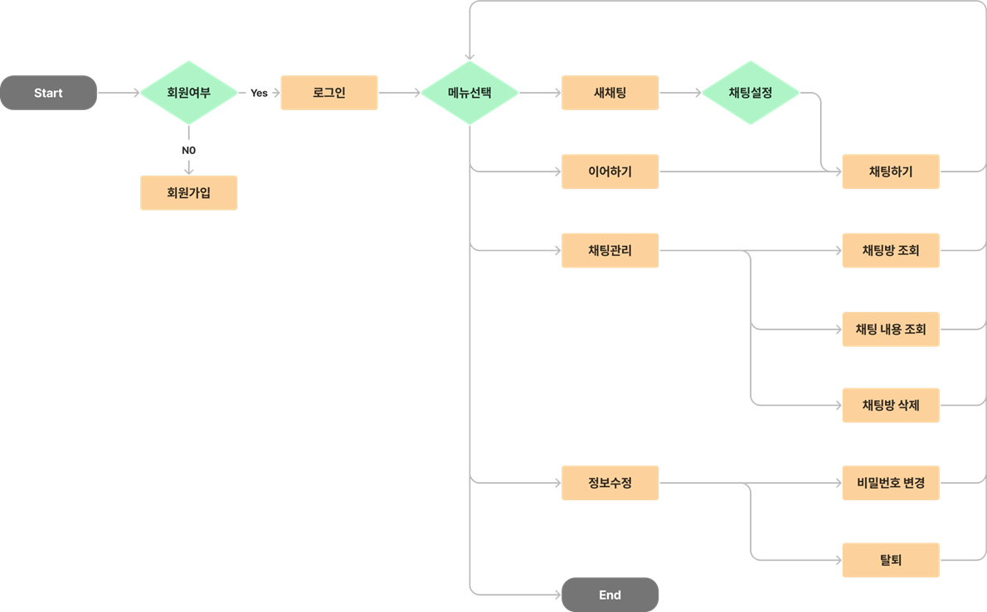
User flow

Slide 10
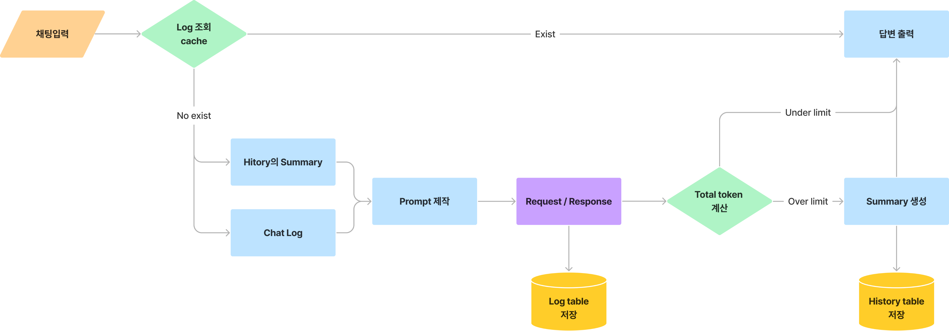
Service logic

Slide 11
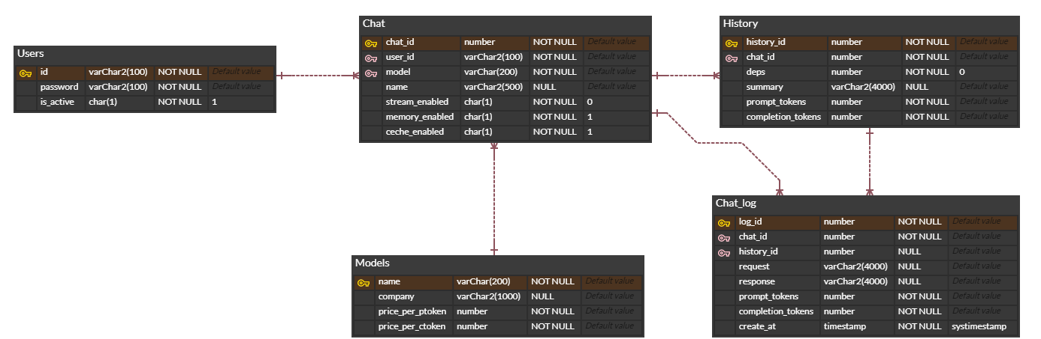
ERD

Slide 12
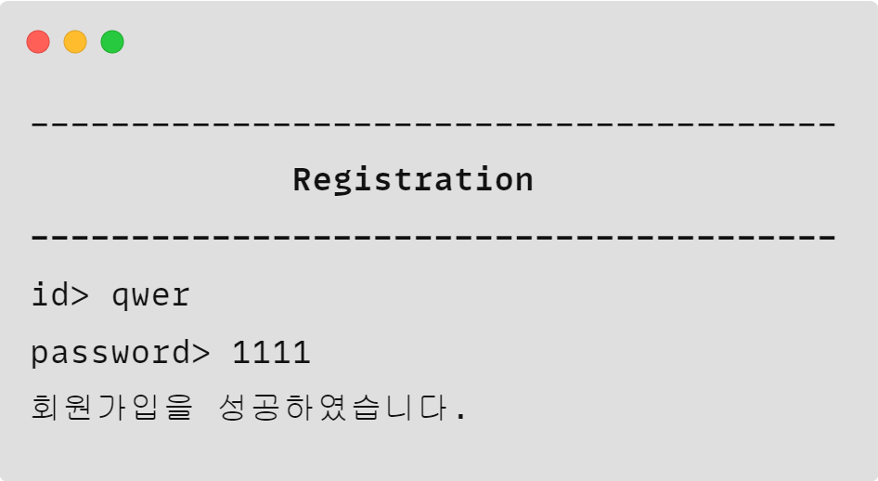
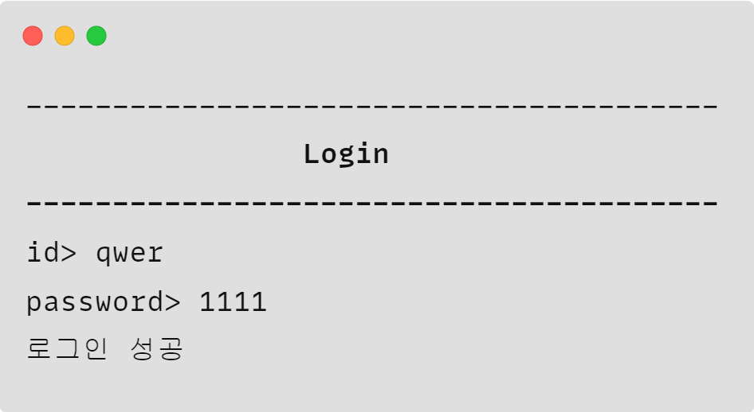
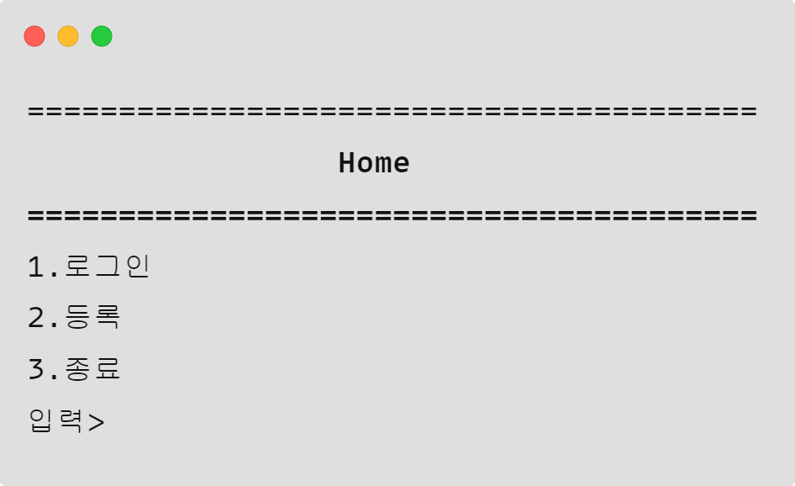
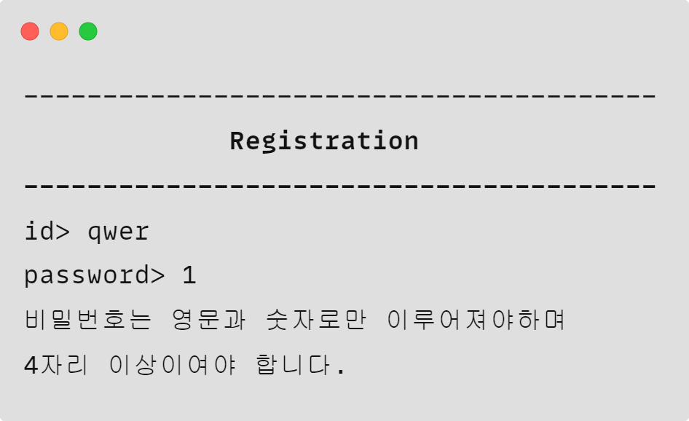
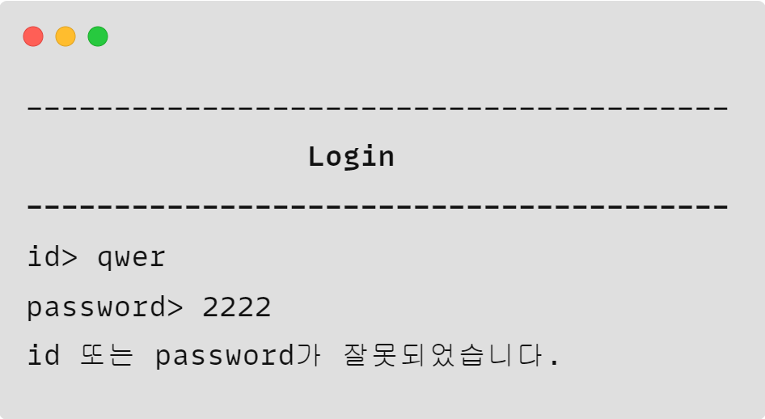
Program views : Home
Home
Registration
Login

Slide 13
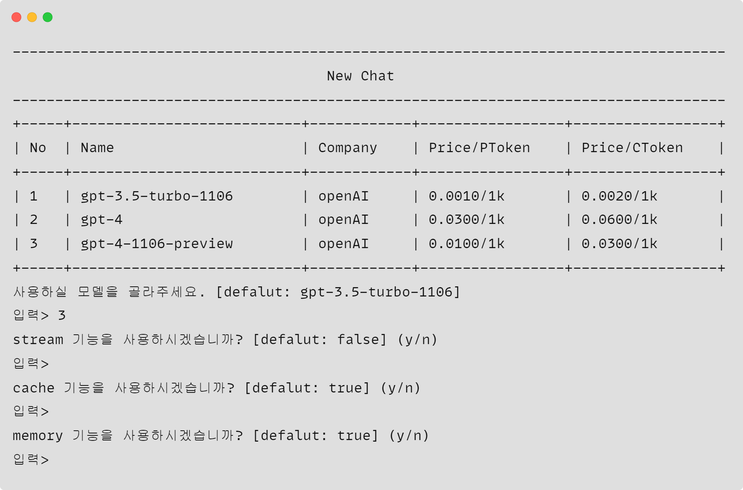
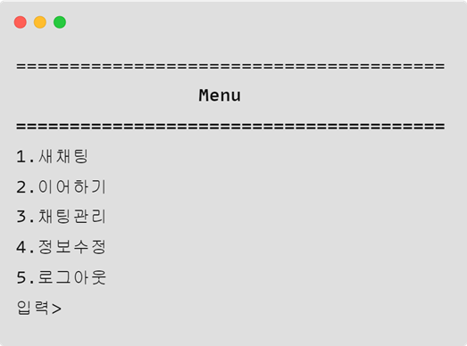
Program views : Menu
Menu
Make new chat

Slide 14
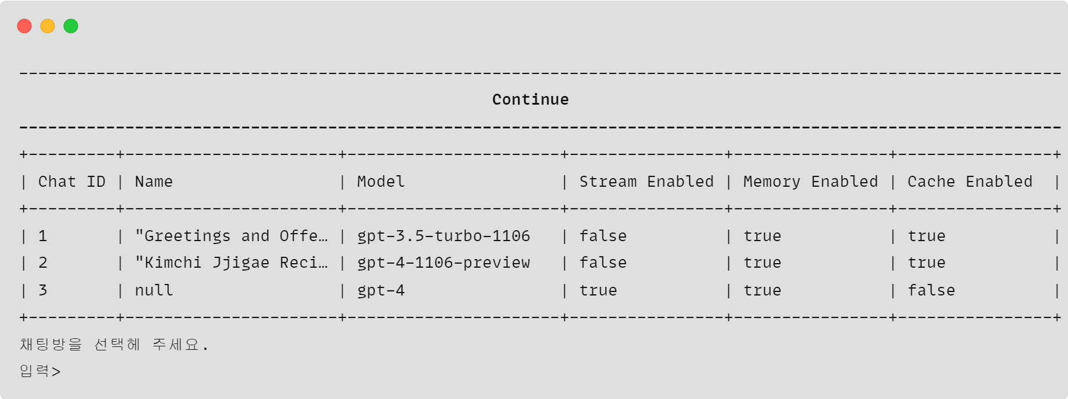
Program views : Menu
Menu
Continue

Slide 15
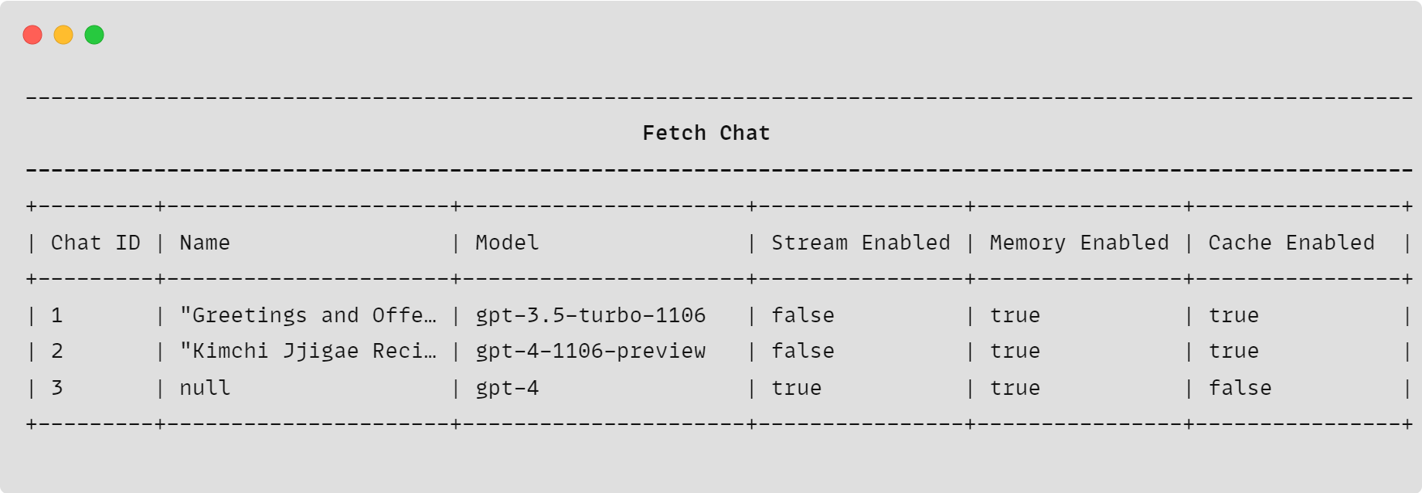
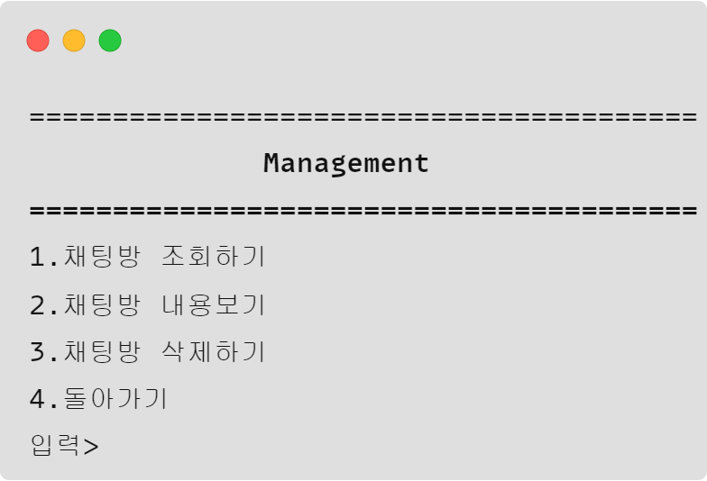
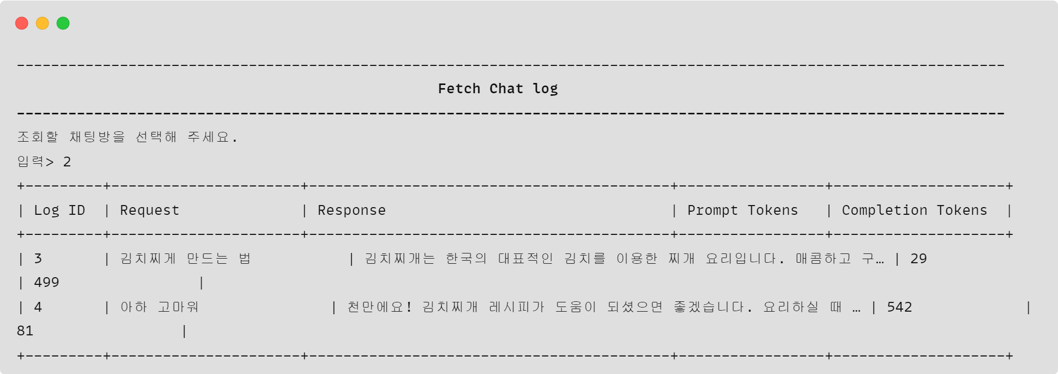
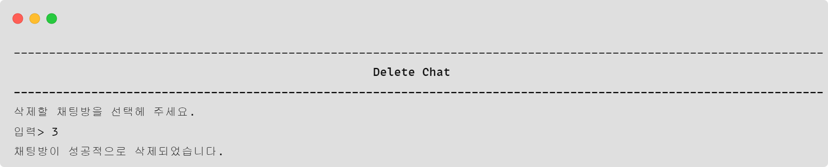
Program views : Management
Management

Slide 16
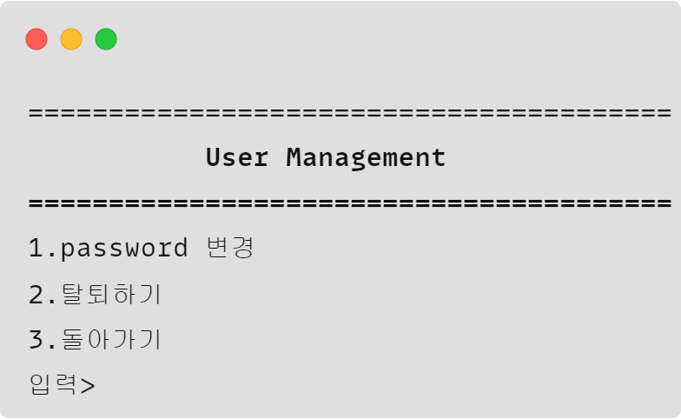
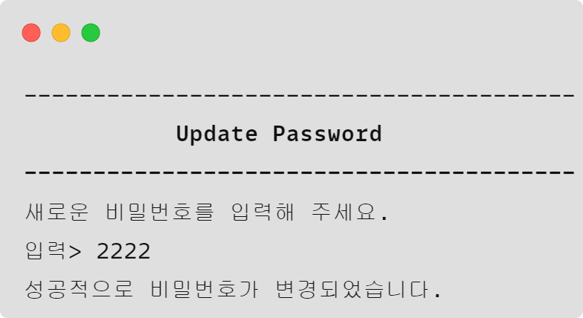
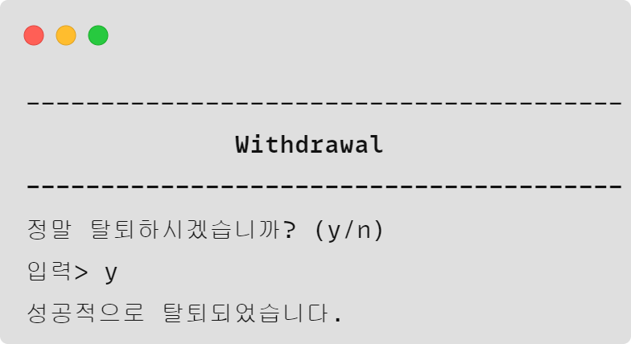
Program views : Management
User management
Update password
Withdrawal

Slide 17
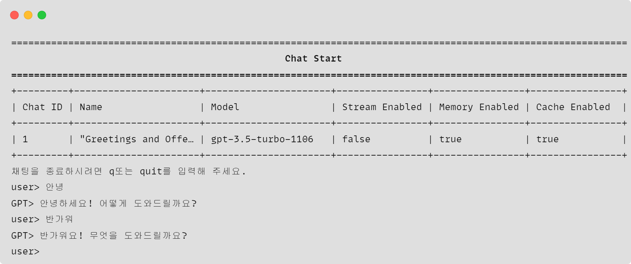
Program views : Chat

Slide 18
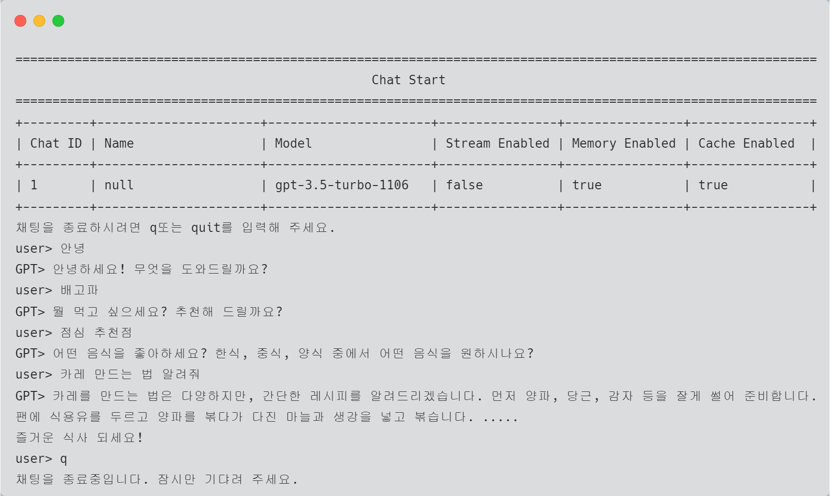
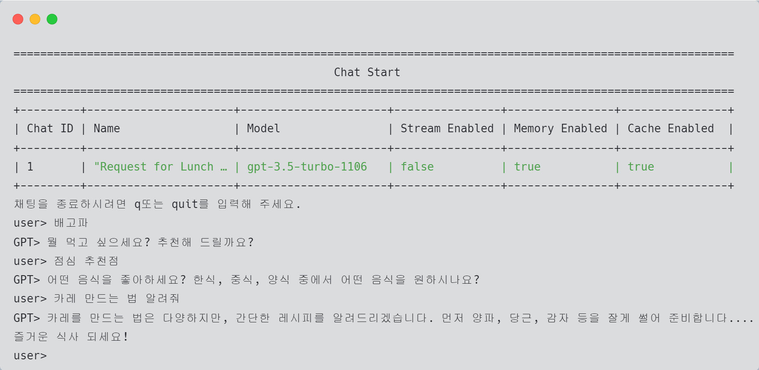
Additional features : generate name
"Request for Lunch Recommendation and Curry Recipe Instructions"
null

Slide 19
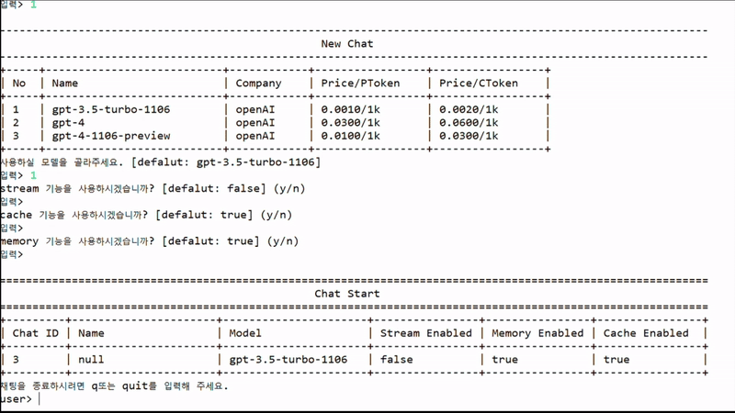
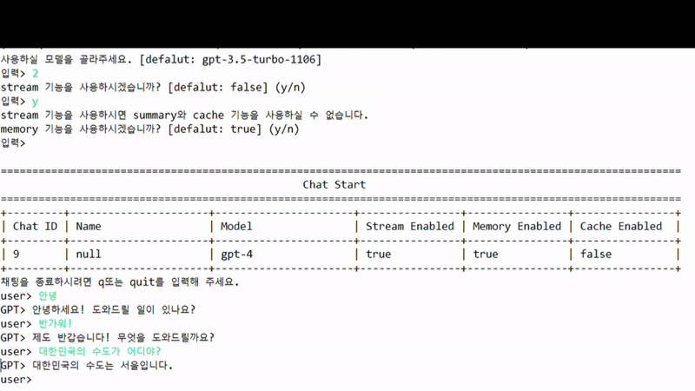
Additional features : Stream
Stream off
Stream on

Slide 20
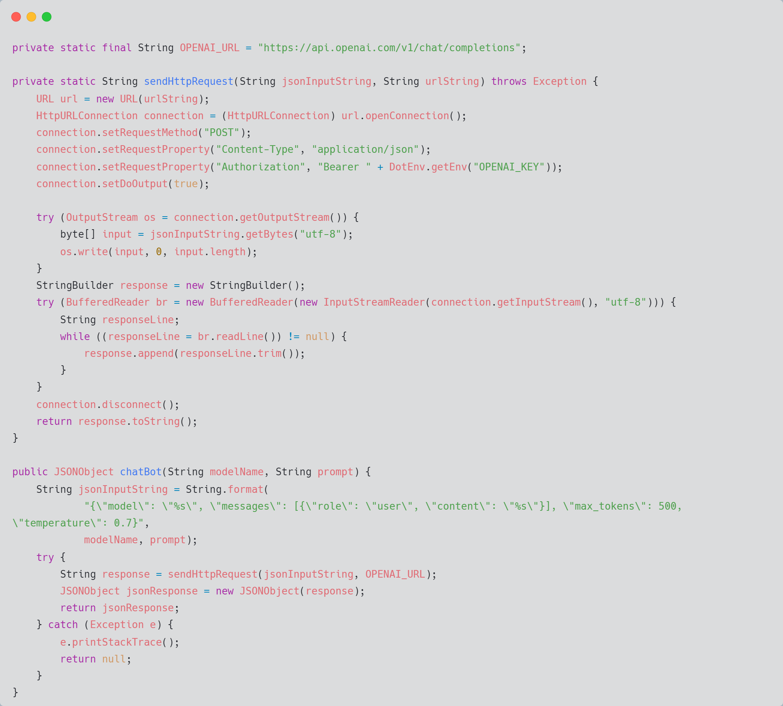
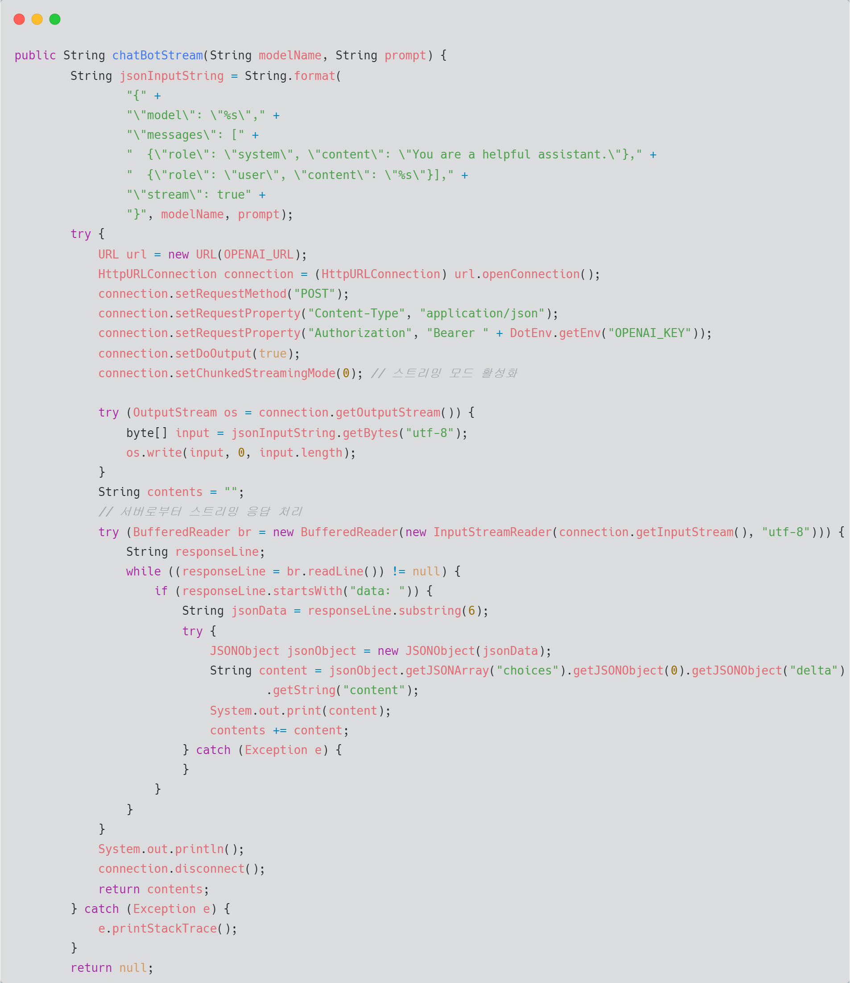
Source code : OpenAIRequest
chatbot : not stream
chatbot : stream

Slide 21
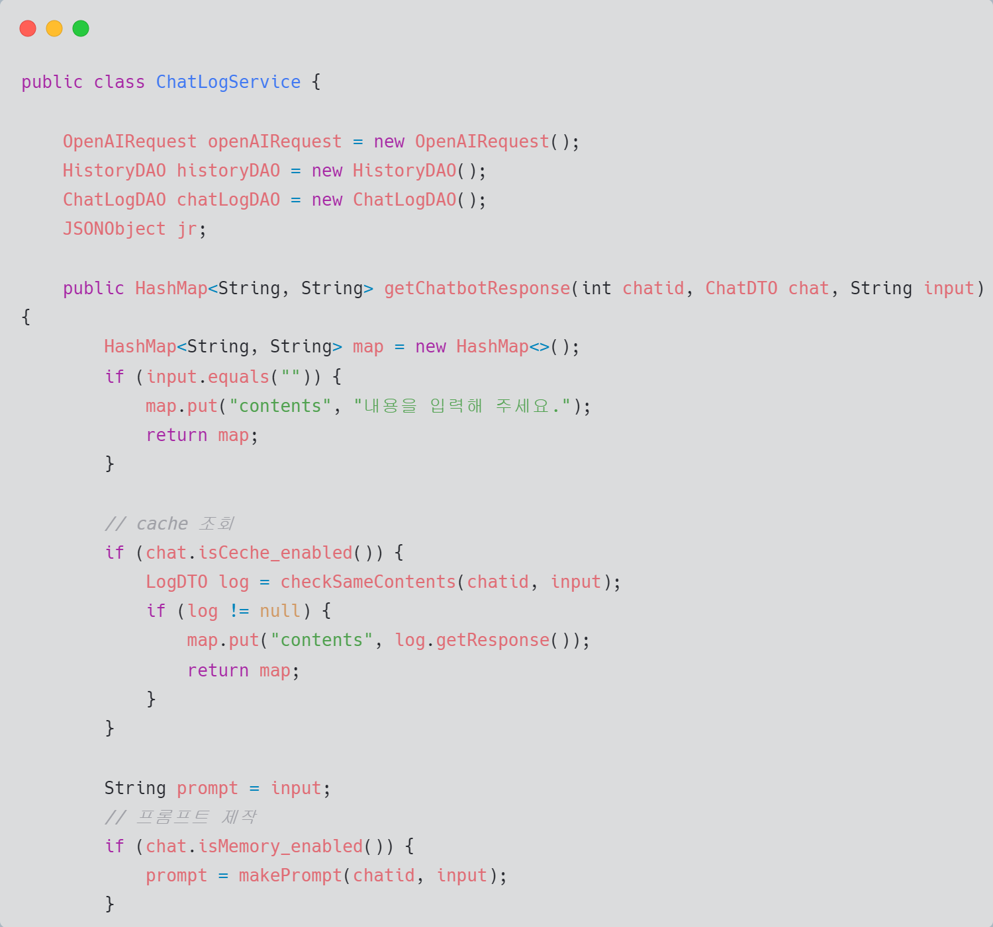
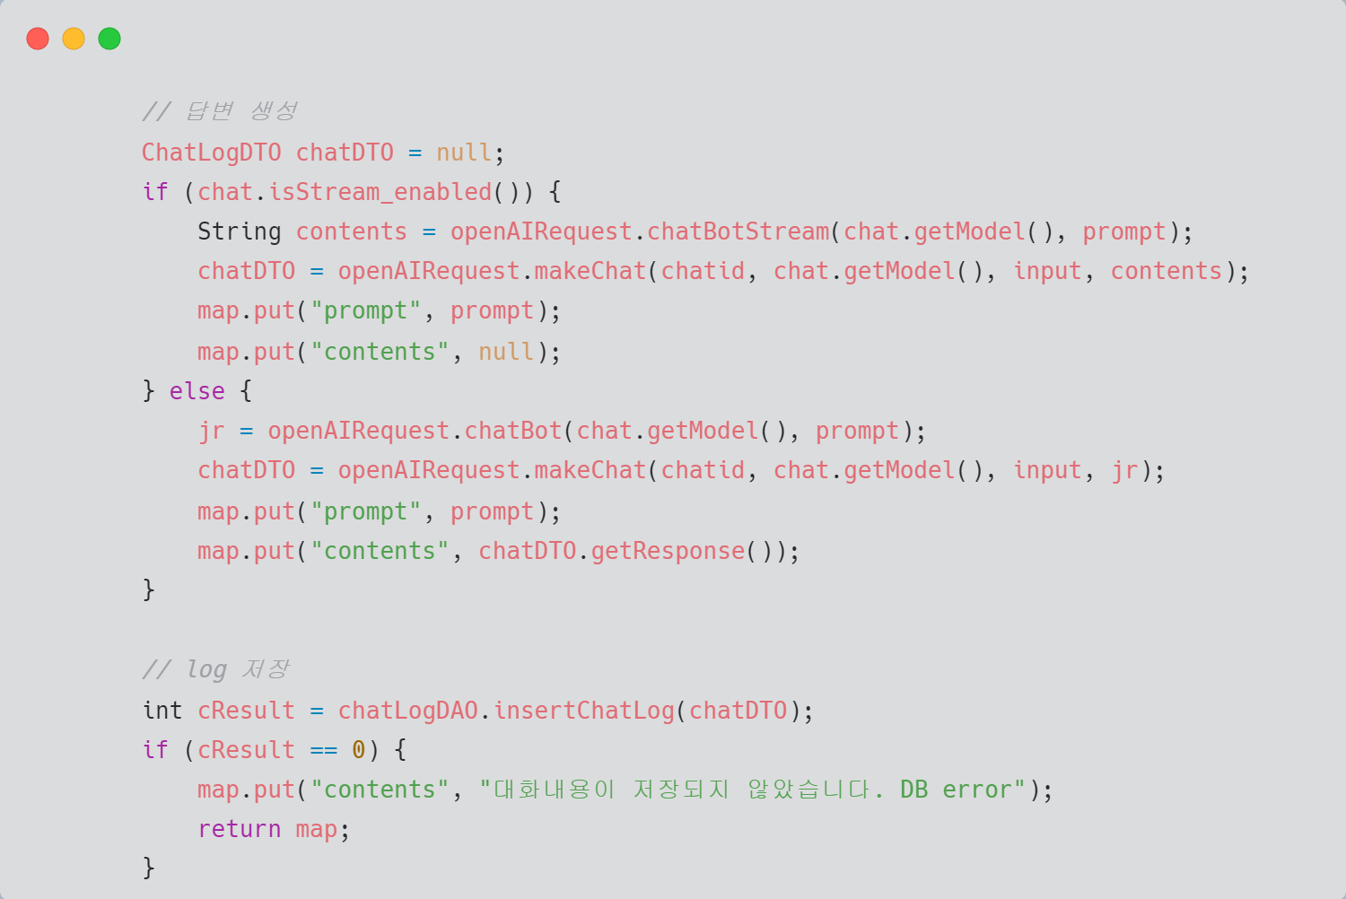
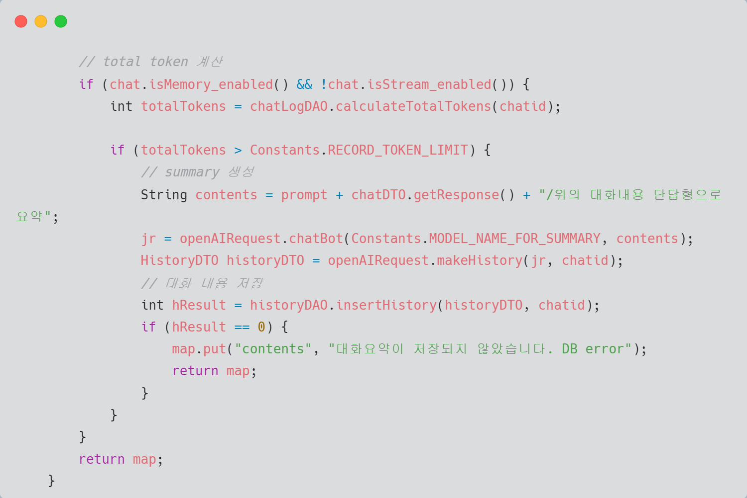
Source code : LogService
Cache, prompt 제작
Response 생성 및 저장
Total token 계산,
Summary 생성

Slide 22
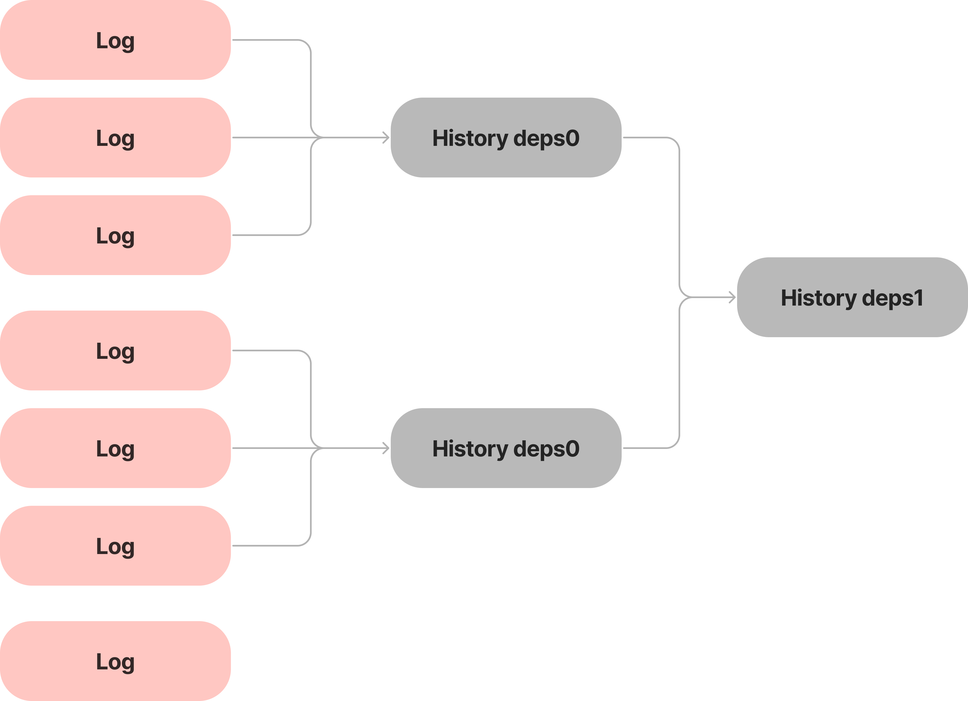

Improvements
"제품 가격은 얼마입니까?"
귀하의 제품 가격 은 얼마 입니까 ?
제품 가격을 알려 주실 수 있나요 ?
귀하의 제품 에 대해 얼마 를 지불 해야 합니까 ?
귀하의 제품에 붙은 가격표는 무엇 입니까?
제품 가격 을 어떻게 알 수 있나요 ?
1. Cache 기능의 낮은 유연성
2. History deps 구현

Slide 23

Thank You

